Slide 1

Loud Smash

Slide 2
Loud Smash
Aladdin Ashraf Ahmed Elnozahy
Group: Web-045A-16Nov YAT
Dr Ehab Habib

Slide 3
Languages Used
1- HTML
2- CSS
3- Bootstrap
4- Javascript
5-Jquery
6-Ajax
7-PHP
8-MYSQLI
9-Laravel framework

Slide 4
Objectives
The website is for music to get informations about your favorite artist and find all his news and to book tickets for his parties

Slide 5
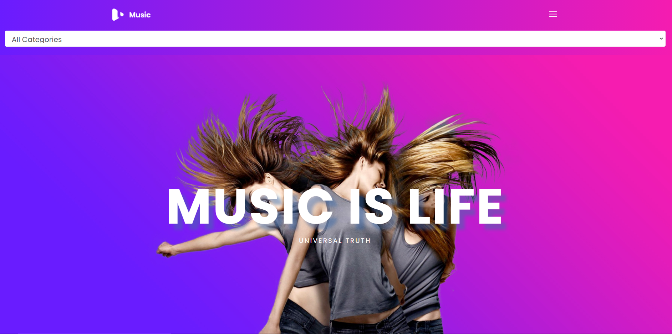

Slide 6
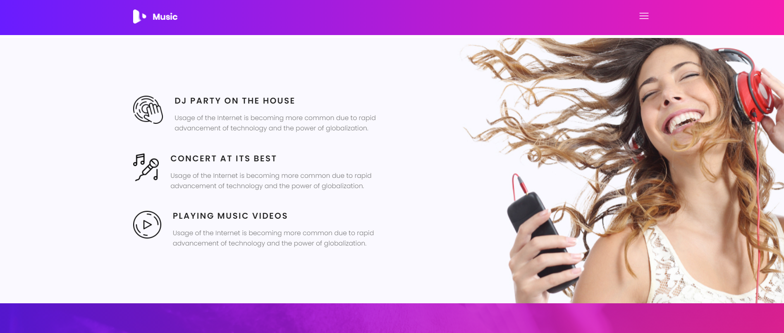

Slide 7
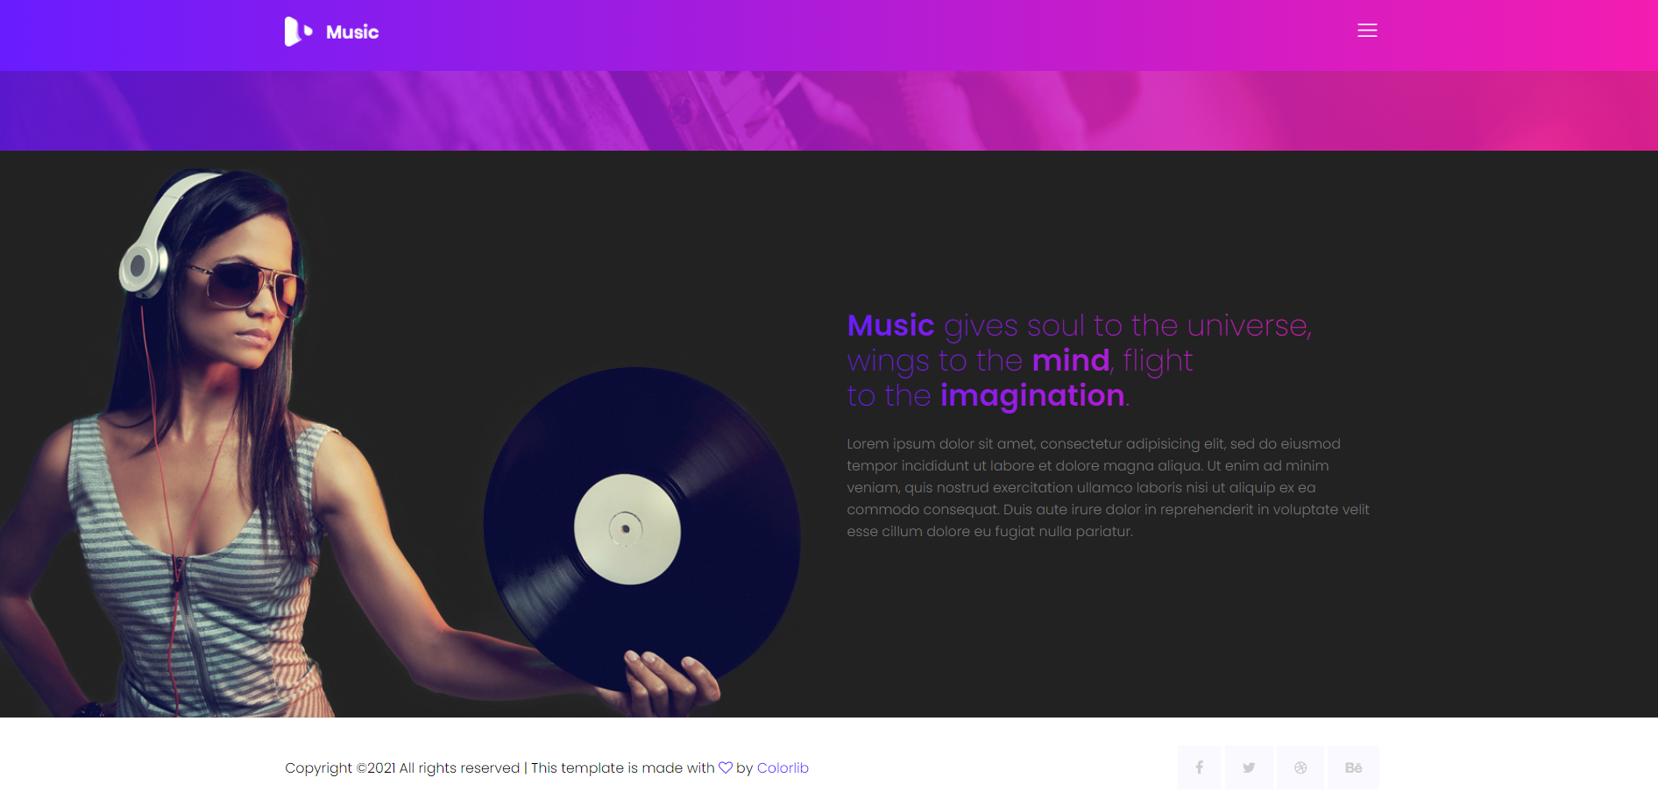

Slide 8
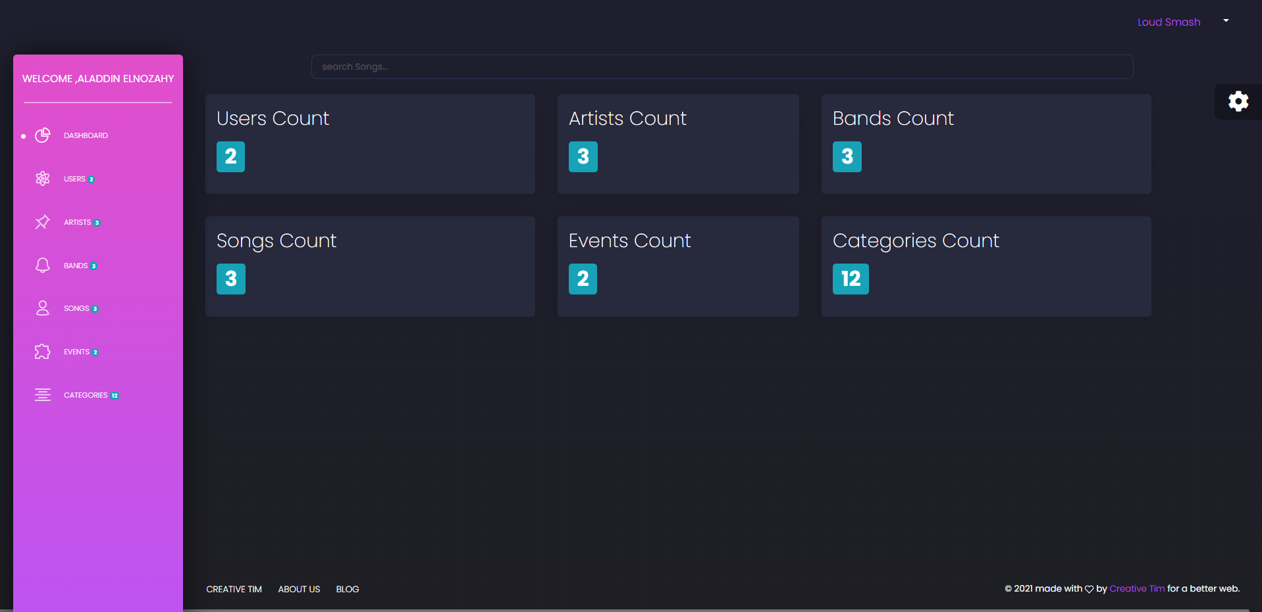

Slide 9
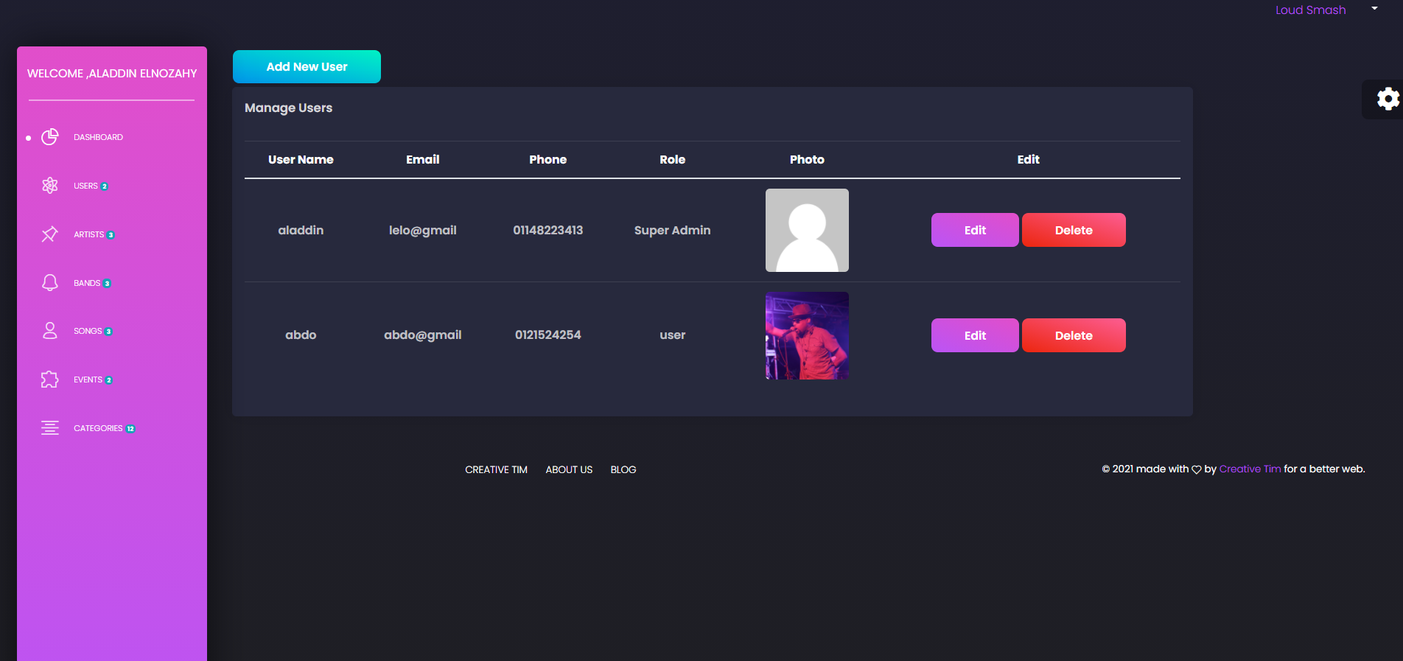

Slide 10
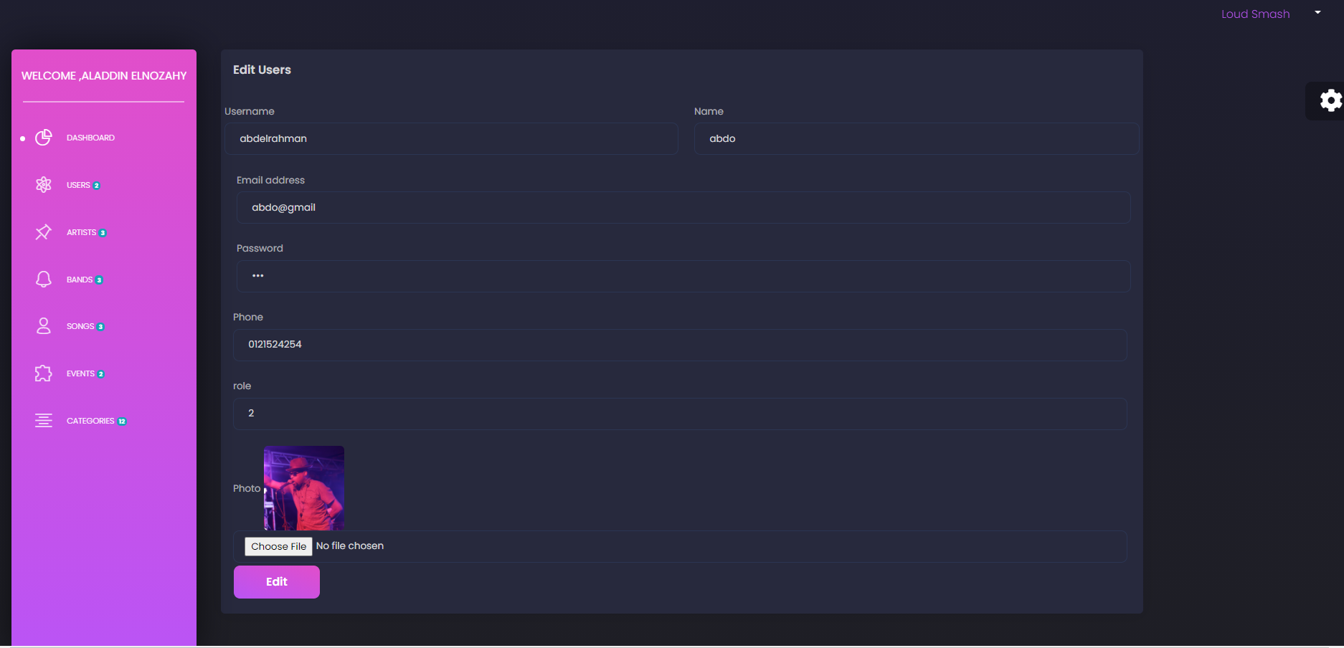

Slide 11
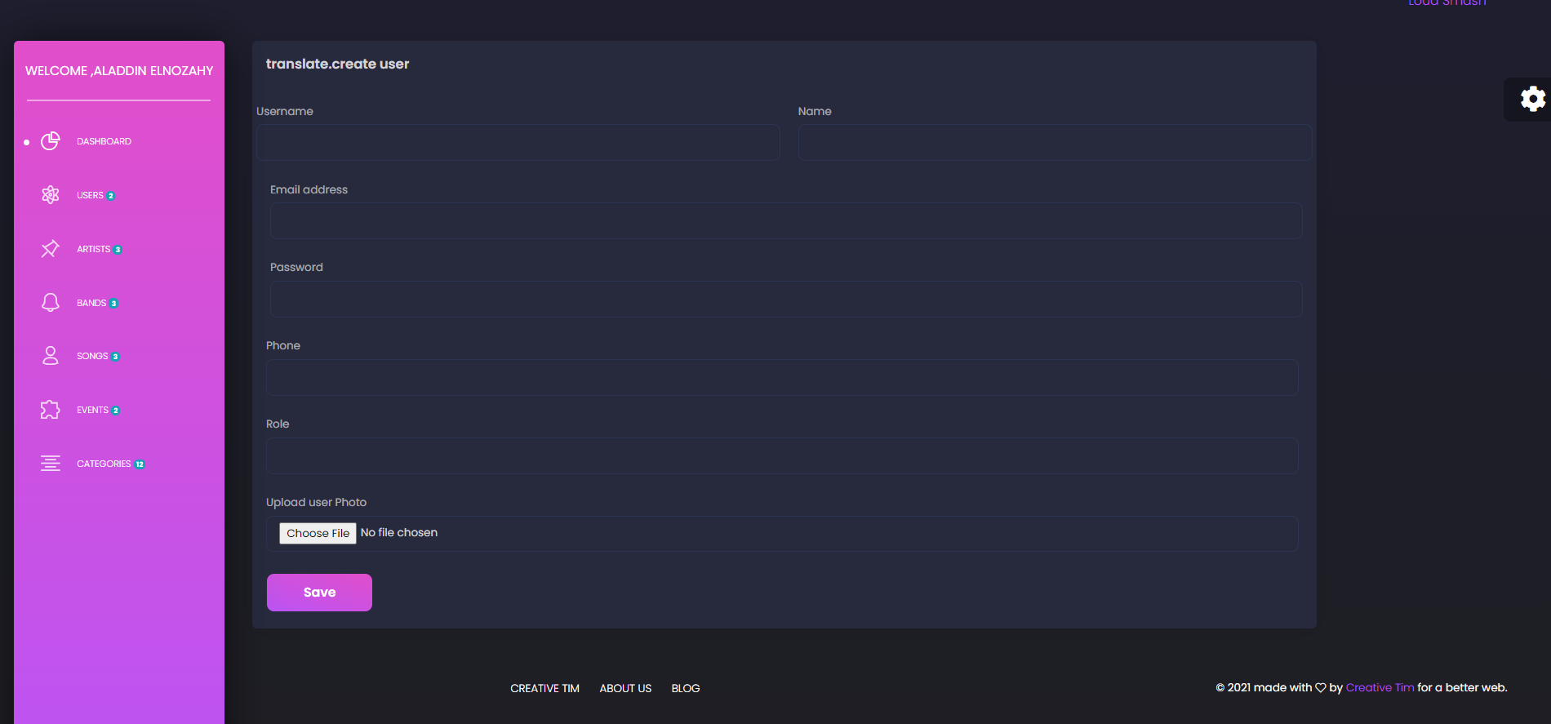

Slide 12
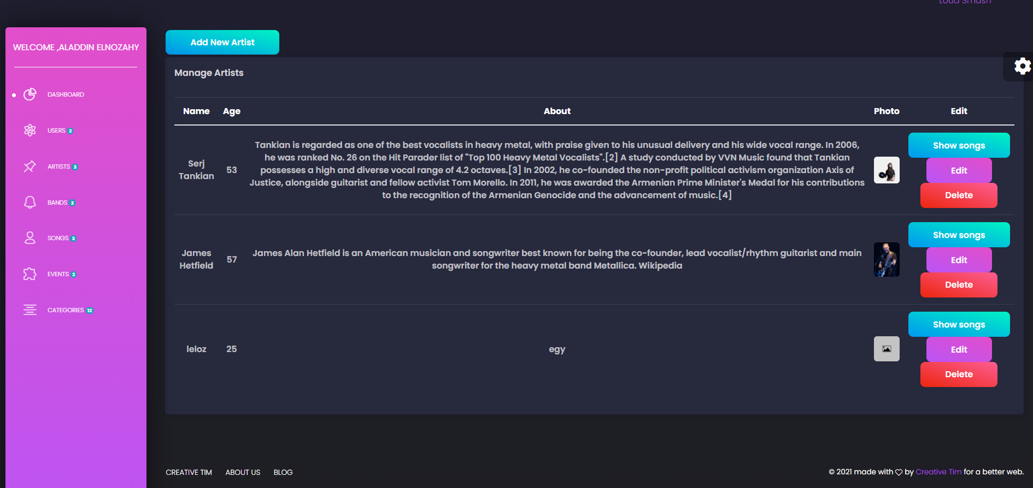

Slide 13
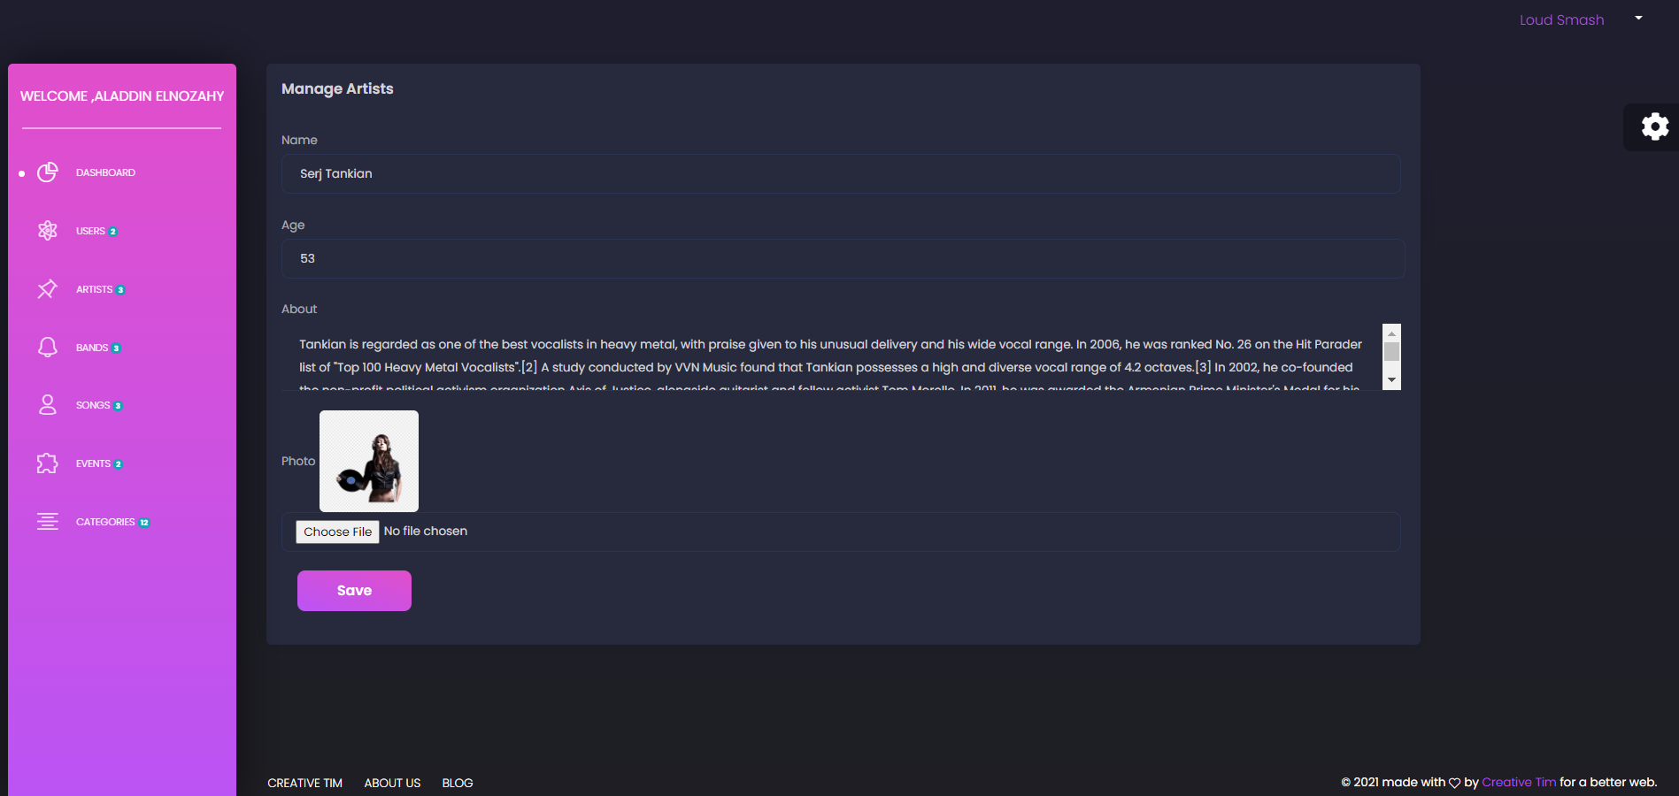

Slide 14
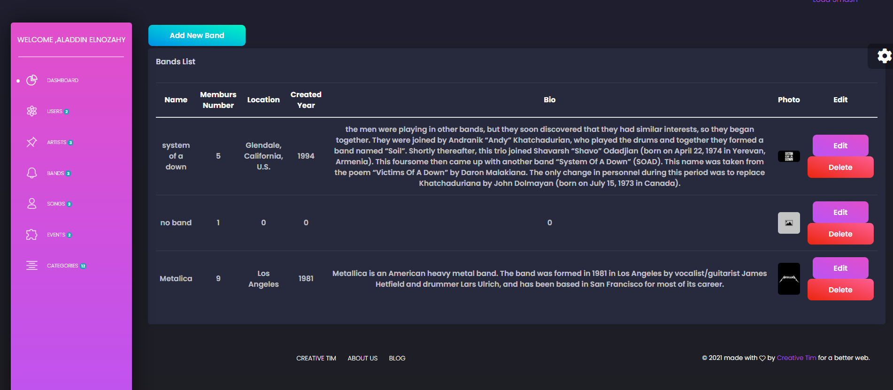

Slide 15
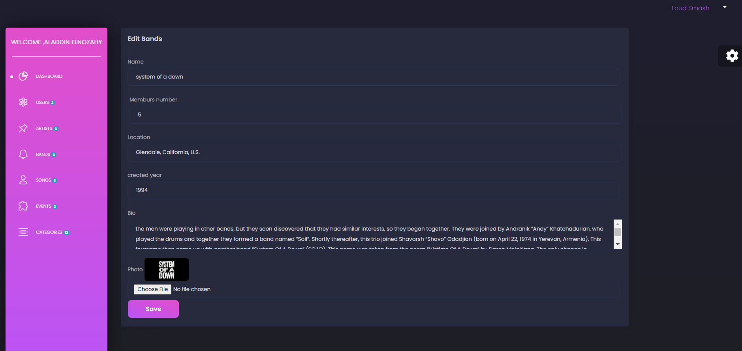

Slide 16
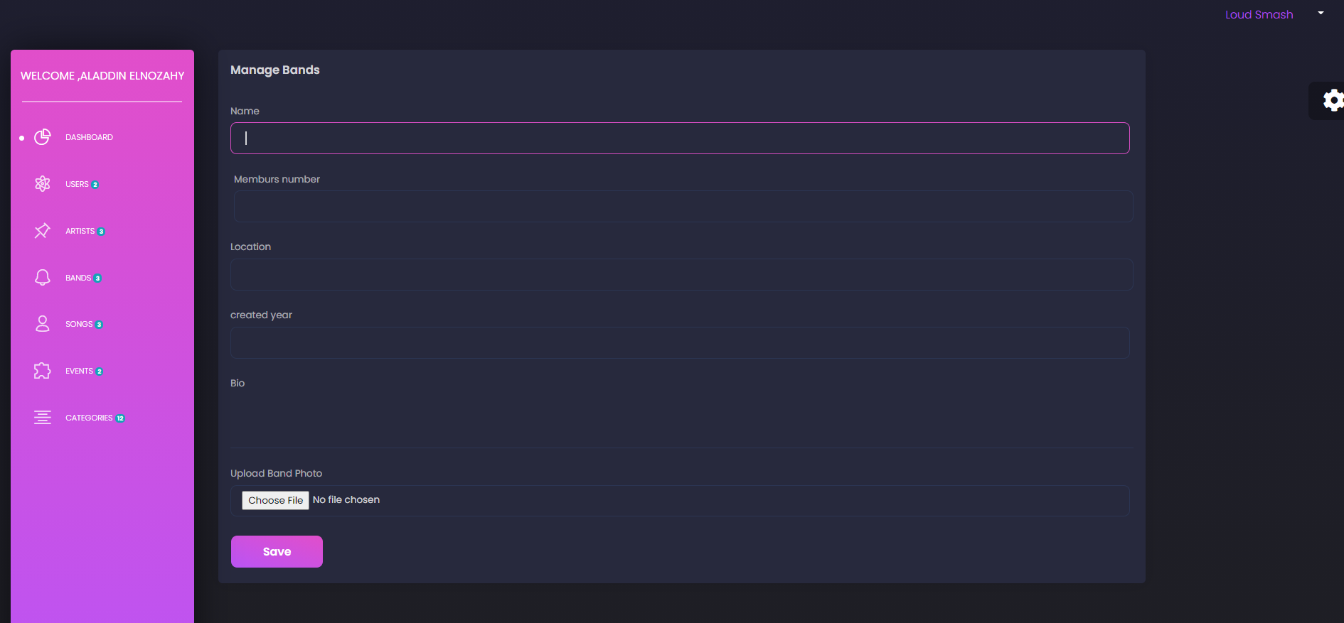

Slide 17
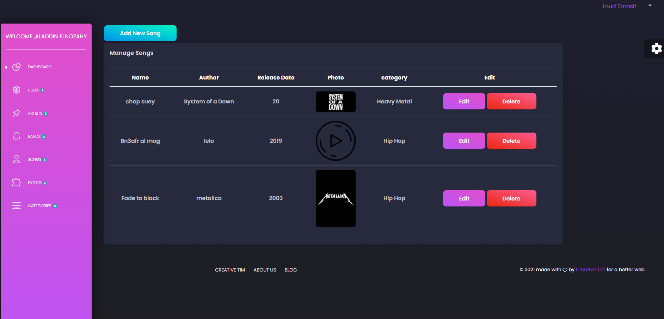

Slide 18
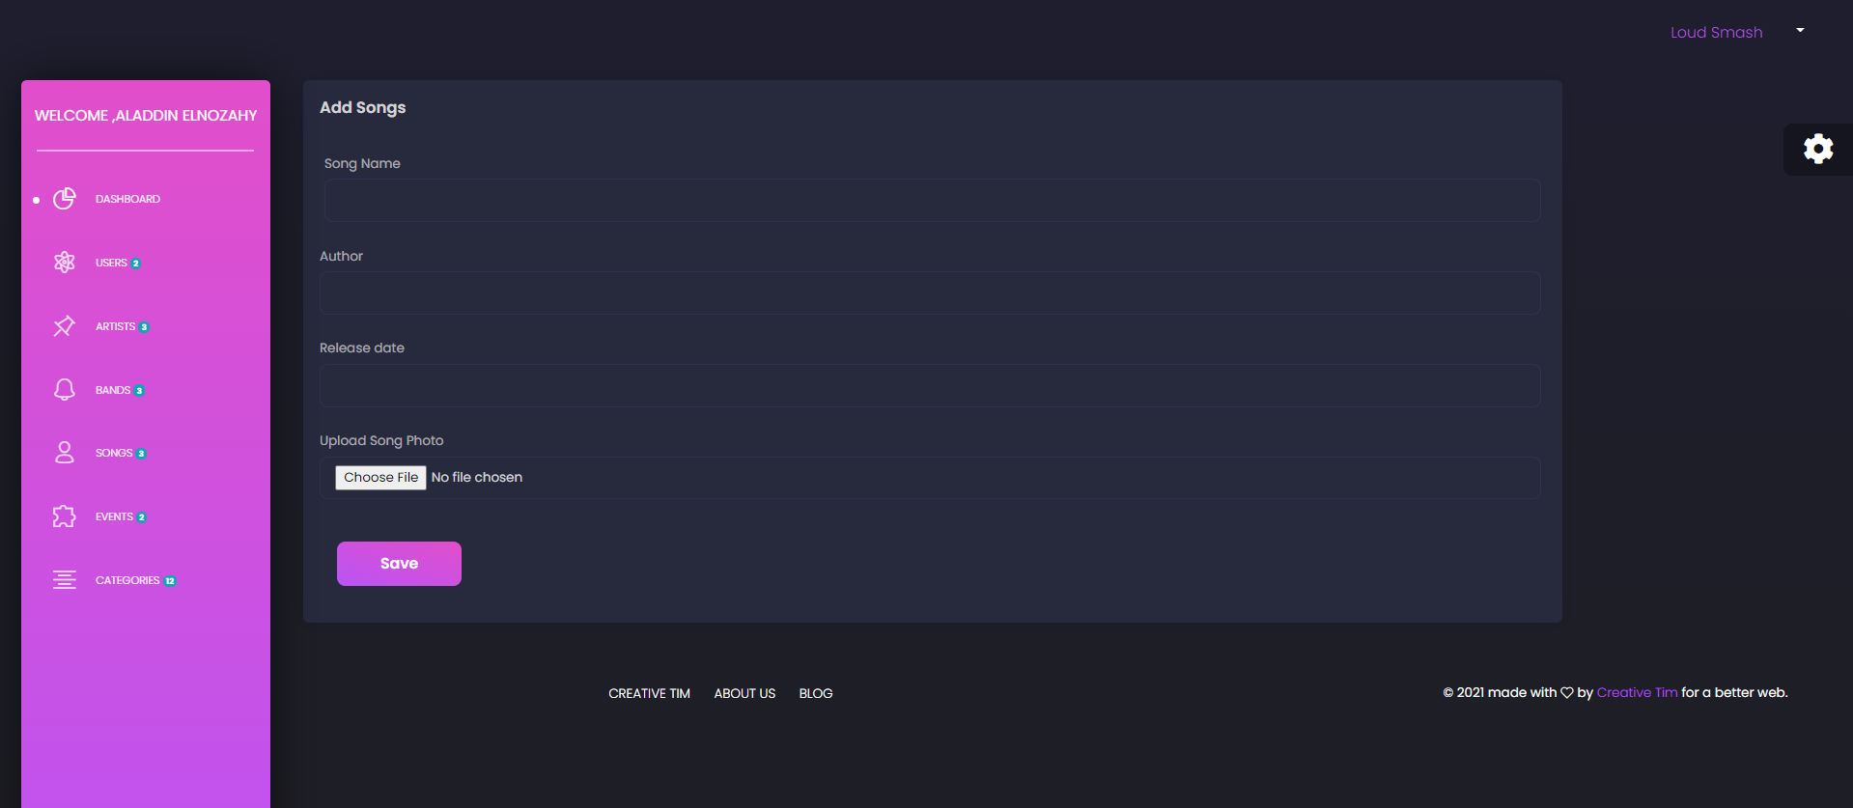

Slide 19
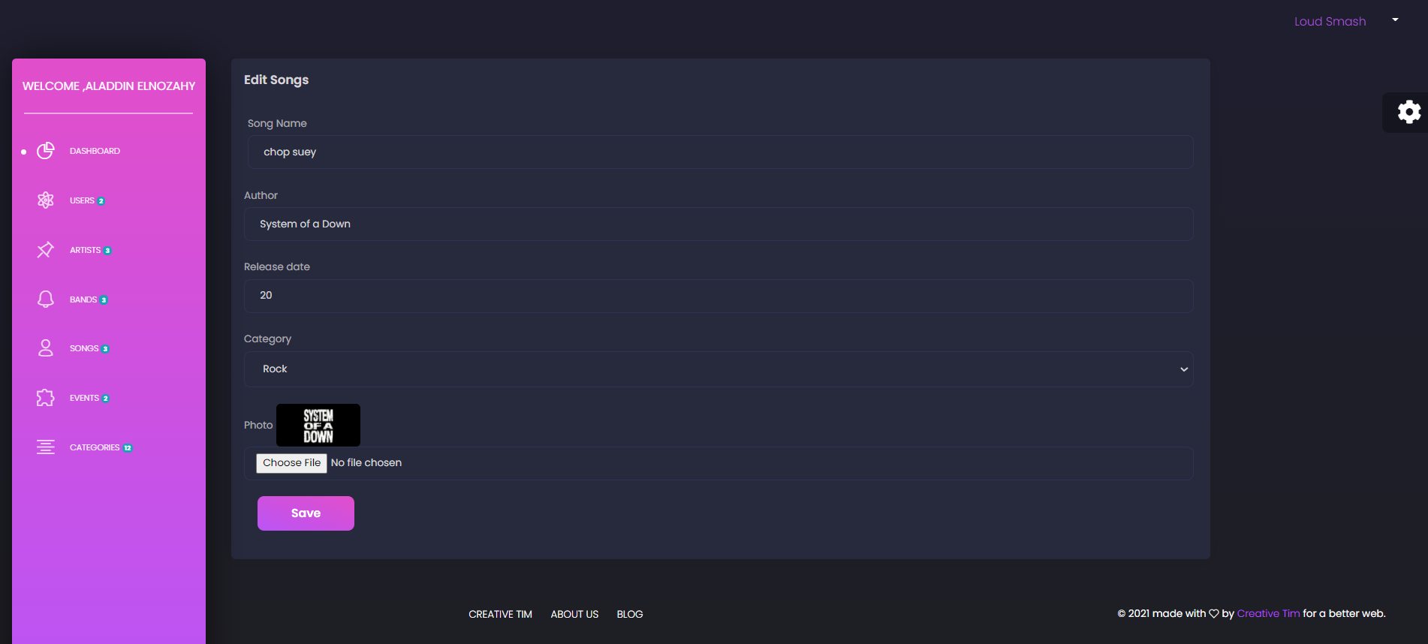

Slide 20
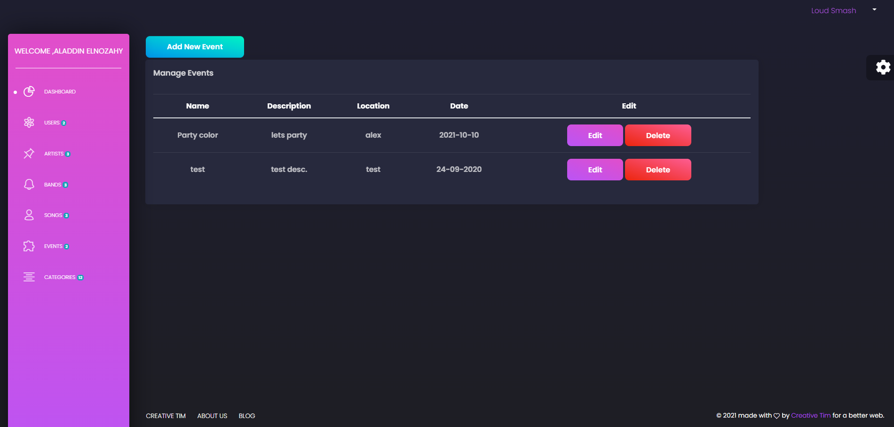

Slide 21
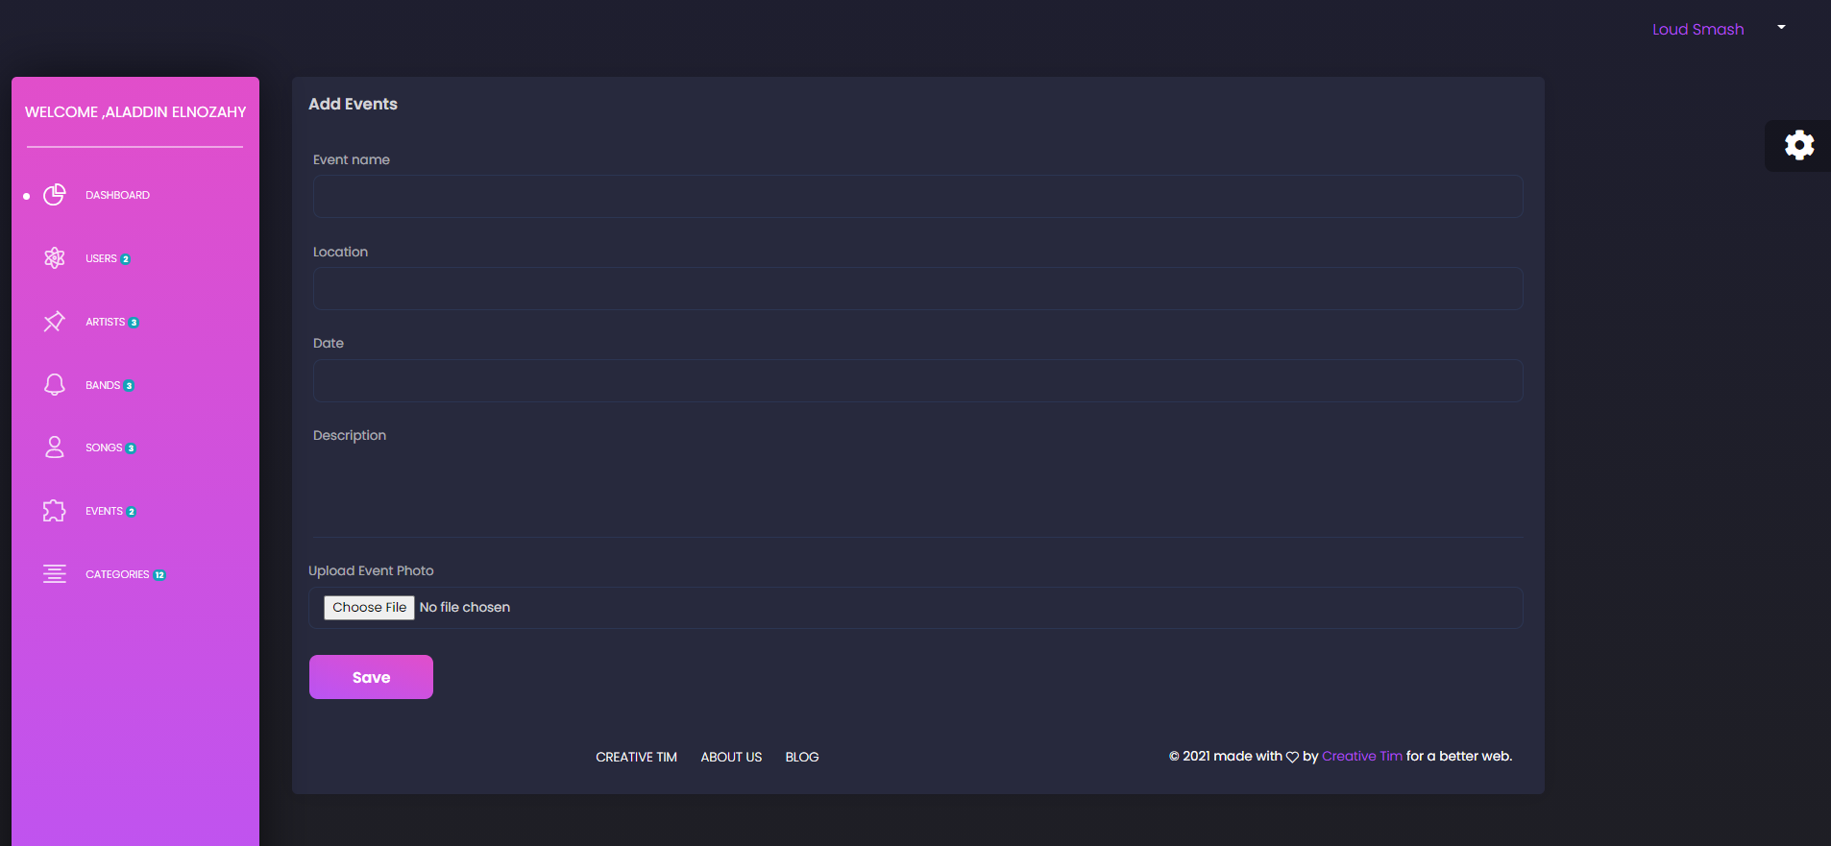

Slide 22
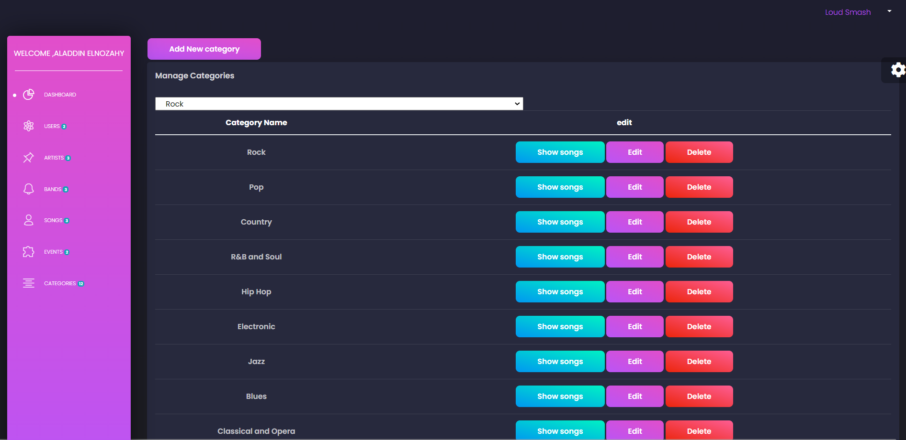

Slide 23
